Slide 1
2 Python Fundamentals
Instructor: Raed Karim
Email: raed.karim@sheridancollege.ca
Course: PROG12583

Slide 2
Python Fundamentals
Objectives
At the end of this module, students will be able to:
Define the fundamentals of computer programming with Python language.
Analyze code syntax.
Apply the programming fundamentals by writing python programs using the IDE (Visual Studio Code).
Identify different types of errors in a program and fix them.
Define and analyze numbers and arithmetic expressions through code.

Slide 3
Python Fundamentals Part - 1

Slide 4
Python Fundamentals
Block of statements:
A statement in Python is the instructions you type in the editor (visual studio code) that interpreter executes, e.g., print(“Hello World!”). Python interpreter executes the print statement and displays the result to the console.
A block is a group of statements in a program or script. Usually, it consists of at least one statement and of declarations for the block, depending on the programming or scripting language. Your code could also contain nested blocks.

Slide 5
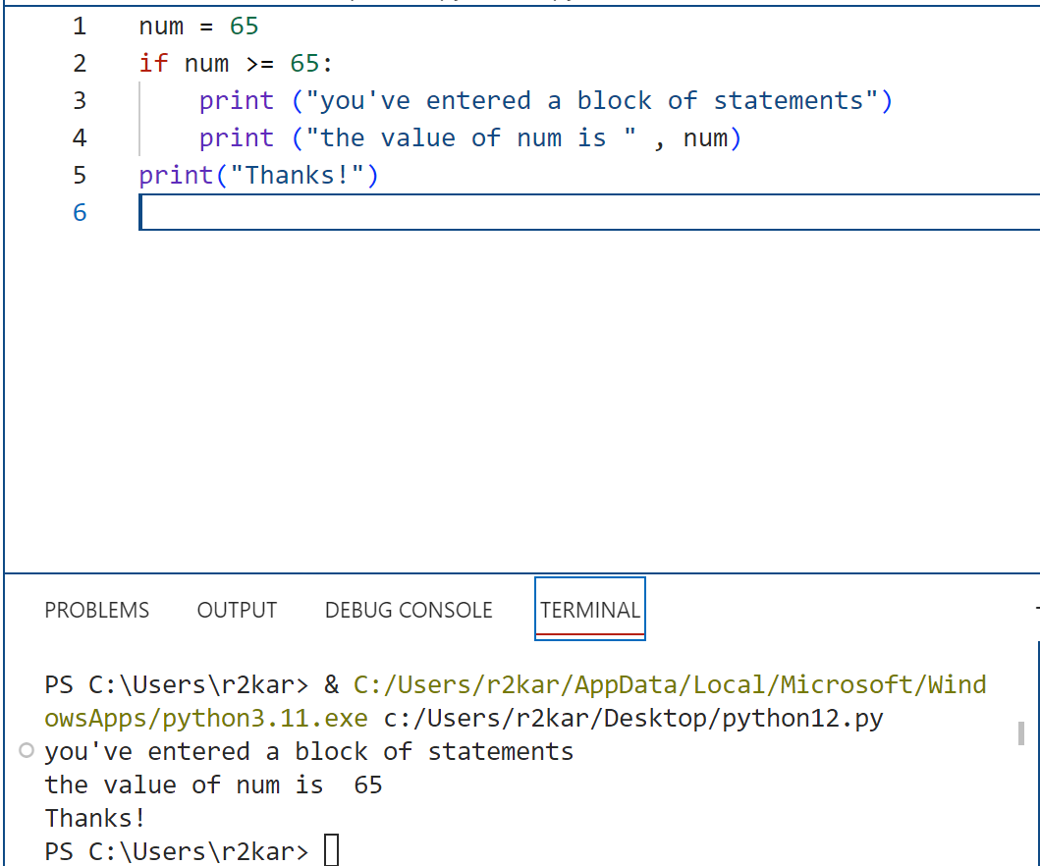
Python Fundamentals
Block of statements: an example of a block of statement (lines 3 and 4)

Slide 6
Python Fundamentals
Rules for coding Python
Python relies on proper indentation.
Unlike many programming languages, the indentation of each line matters in a Python program. With Python, the indentation is typically four spaces (or one tab).
Python doesn't use braces { } to indicate blocks of code for class and function definitions or flow control.
Blocks of code are denoted by line indentation, which is rigidly enforced. All statements within the block must be indented the same amount.

Slide 7
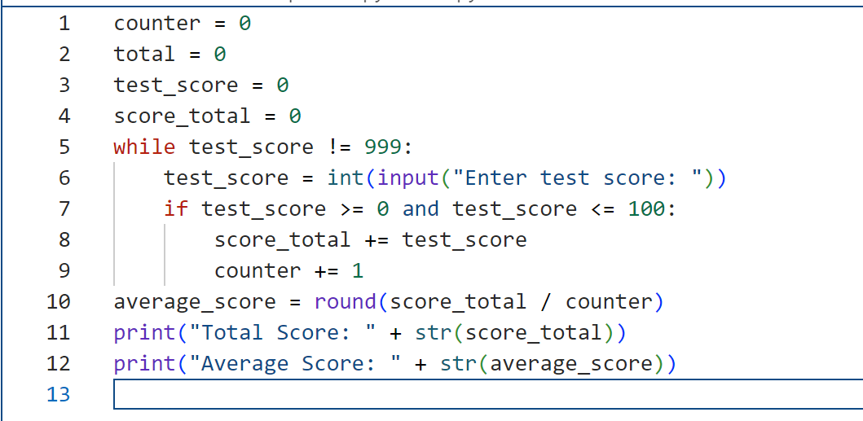
Python Fundamentals
Indentation Examples:
A good indentation in Python:

Slide 8
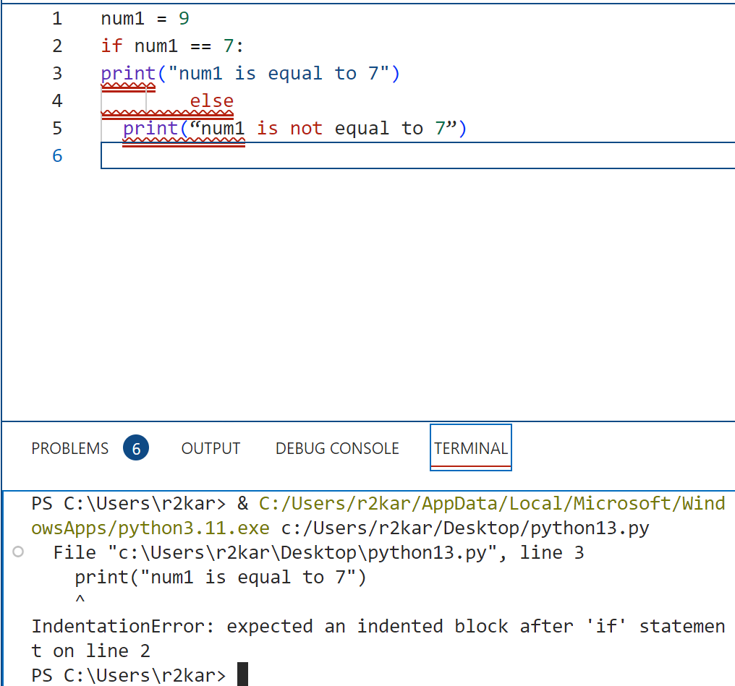
Python Fundamentals
Indentation Examples:
An indentation that causes an error:

Slide 9
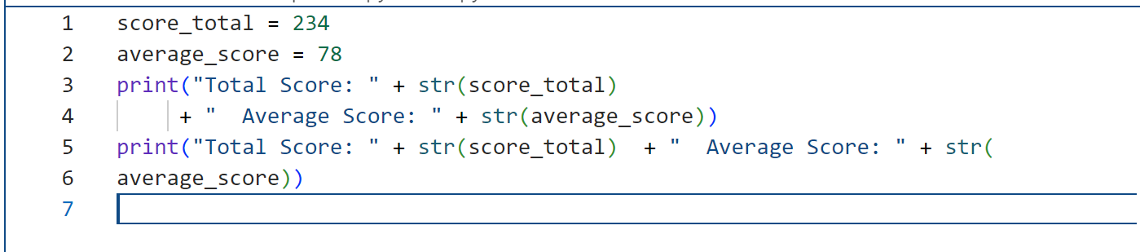
Python Fundamentals
Statement continuation:
You can use implicit continuation.
To do that, you divide a statement before or after an operator like a plus or minus sign.
You can also divide a statement after an opening parenthesis.

Slide 10
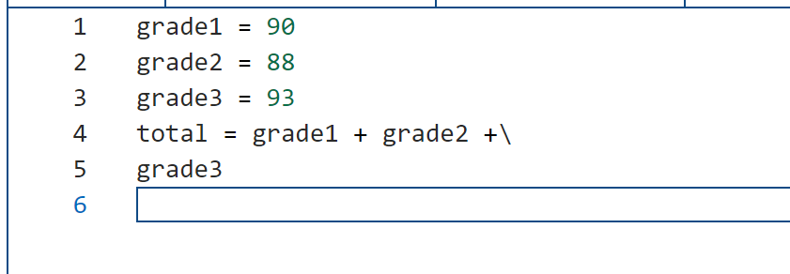
Python Fundamentals
Statement continuation:
You can also use explicit continuation.
To do that, you code a backslash to show that a line is continued.
However, this way is discouraged.

Slide 11
Python Fundamentals
Comments:
Adding comments to programs is a very important practice in programming.
Comments are added for people (not the computer) to understand what a part of the program does – they are notes added by programmers to explain part for the code.
Python interpreter ignores the comments – it does not execute them. They have no effect on the operation of the program.

Slide 12
Python Fundamentals
Comments:
To add a comment to describe a portion of the code, type # then type the python statement.
You can also add a comment after the statement (inline comments).
Another way to add a comment is by commenting out a python statement, if you don’t want the interpreter to execute that statement (this is mainly for testing purpose).

Slide 13
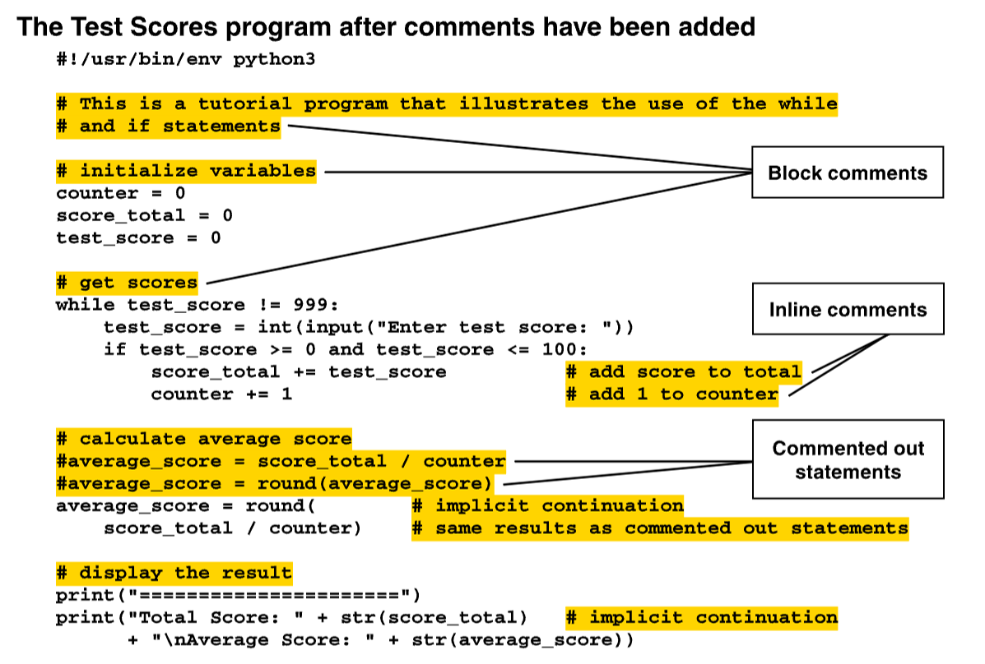
Python Fundamentals
Comment examples:

Slide 14
Python Fundamentals
Quotation in Python:
In programming terms, a sequence of characters that is used as data is called a string.
When a string appears in the actual code of a program, it is called a string literal.
In Python code, string literals must be enclosed in quote marks.

Slide 15
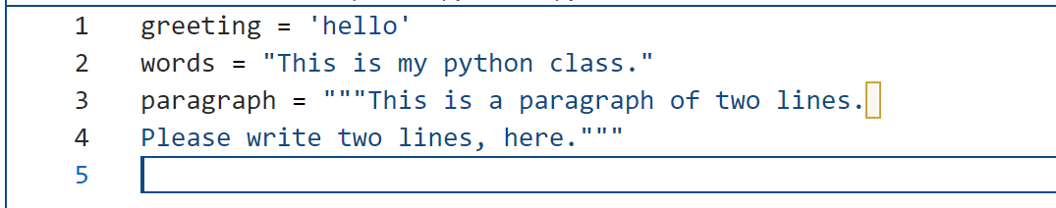
Python Fundamentals
Quotation in Python:
Python accepts single ('), double (") and triple (''' or """) quotes to denote string literals, as long as the same type of quote starts and ends the string.
The triple quotes are used to span the string across multiple lines. In this case, the string can be a comment.

Slide 16
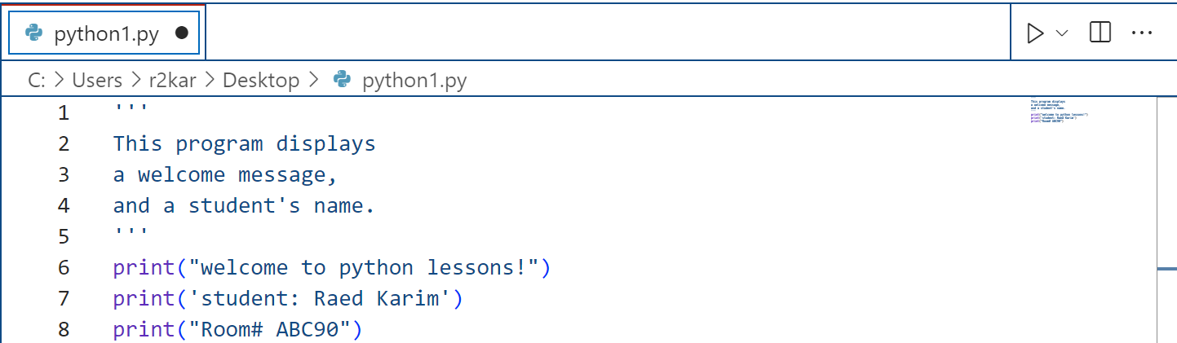
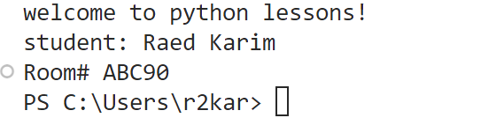
Python Fundamentals
Quotation in Python:
The quote marks are not displayed when the statement executes.
The quote marks simply specify the beginning and the end of the text that you wish to display.
output

Slide 17
Python Fundamentals
Quotation in Python:
If you want a string literal to contain either a single-quote or an apostrophe as part of the string, you can enclose the string literal in double-quote marks.
Likewise, you can use single-quote marks to enclose a string literal that contains double-quotes as part of the string.
output

Slide 18
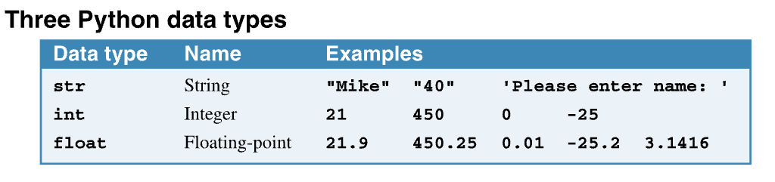
Python Fundamentals
Working with datatypes and variables in Python:
We saw three different types of data in the previous examples – string (str), integer (int) and floating-point (float).
The str data type holds string literals.
The int and float data types hold numerical literals.

Slide 19
Python Fundamentals
Working with datatypes and variables in Python:
When you develop a python program, you work with variables that store data (values). Variables vary as code executes.
To work with variables, you assign data to them using the assignment operator (=). This is called (assignment statement).
Initialization is when assign an initial value to a variable. Then different values are assigned later in the program.
You can assign literal values or literal strings to a variables.

Slide 20
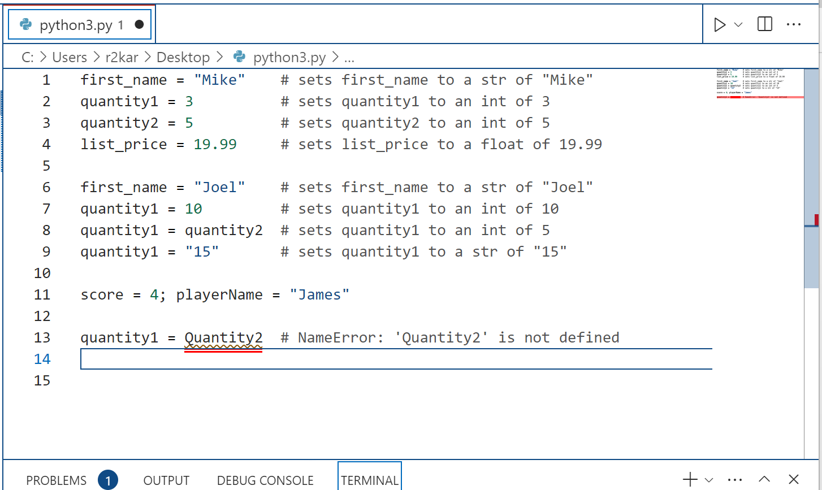
Python Fundamentals
Working with datatypes and variables in Python:
To code a literal value for a string, enclose the characters of the string in single or double quotation marks. This is called a string literal.
To code a literal value for a number, code the number without quotation marks. This is called a numeric literal.

Slide 21
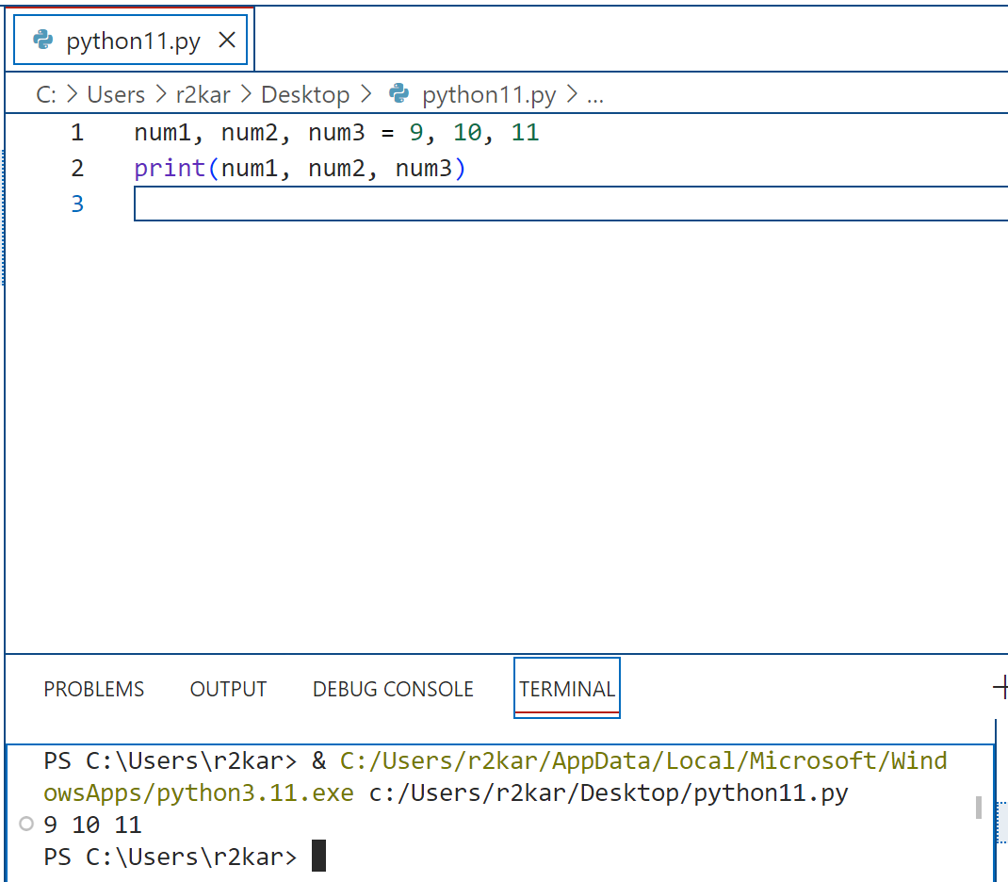
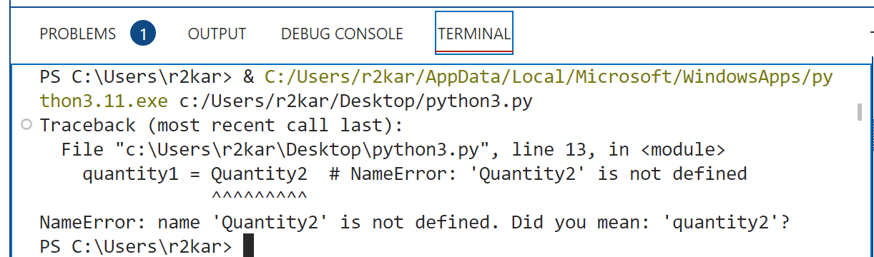
Python Fundamentals
Working with datatypes and variables in Python:
You can also assign multiple values to multiple variables in one statement.
Because variable names are case-sensitive, you must be sure to use the correct case when coding the names of variables.

Slide 22
Python Fundamentals
Working with datatypes and variables in Python:
Variables naming conventions that must be respected by programmers
A variable name must begin with a letter or underscore.
A variable name can’t contain spaces, punctuation, or special characters other than the underscore.
A variable name can’t begin with a number, but can use numbers later in the name.
Use underscore notation or camel case.
Use meaningful names that are easy to remember.
Don’t use the names of built-in functions, such as print().

Slide 23
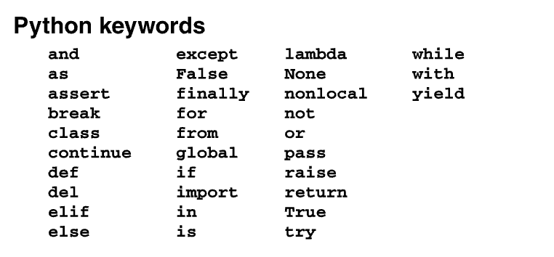

Python Fundamentals
Working with datatypes and variables in Python:
Variables naming conventions
A variable name can’t be the same as a keyword that’s reserved by Python.
Two naming styles for variables

Slide 24
Python Fundamentals
The print() function:
The print function is one of the most important built-in functions in python that you will be using to print out and display the results (outputs) of the code to the screen.
A function is a reusable unit of code that performs a specific task.
Python provides many built-in functions that do common tasks like getting input data from the user and printing output data to the console.

Slide 25
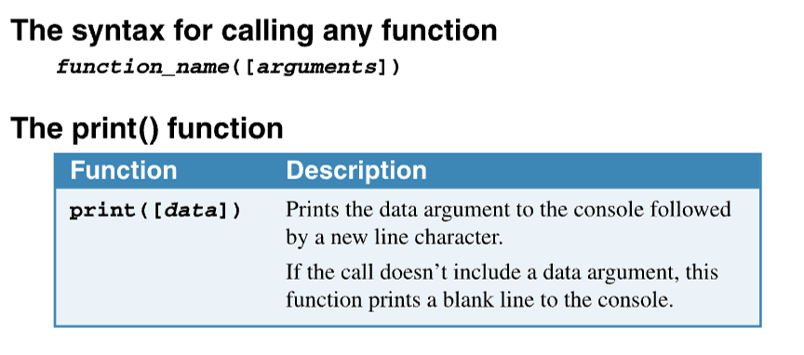
Python Fundamentals
The print() function:
When you call a function, you code the name of the function followed by a pair of parentheses.
Within the parentheses, you code any arguments (could values of variables) that the function requires, and you separate multiple arguments with commas.
In a syntax summary like the one at the top of this page, brackets [ ] mark the portions of code that are optional.
The italicized portions of the summary are the ones that you have to supply.
But note that the arguments are optional. If no arguments are passed to this function, it prints a blank line.

Slide 26
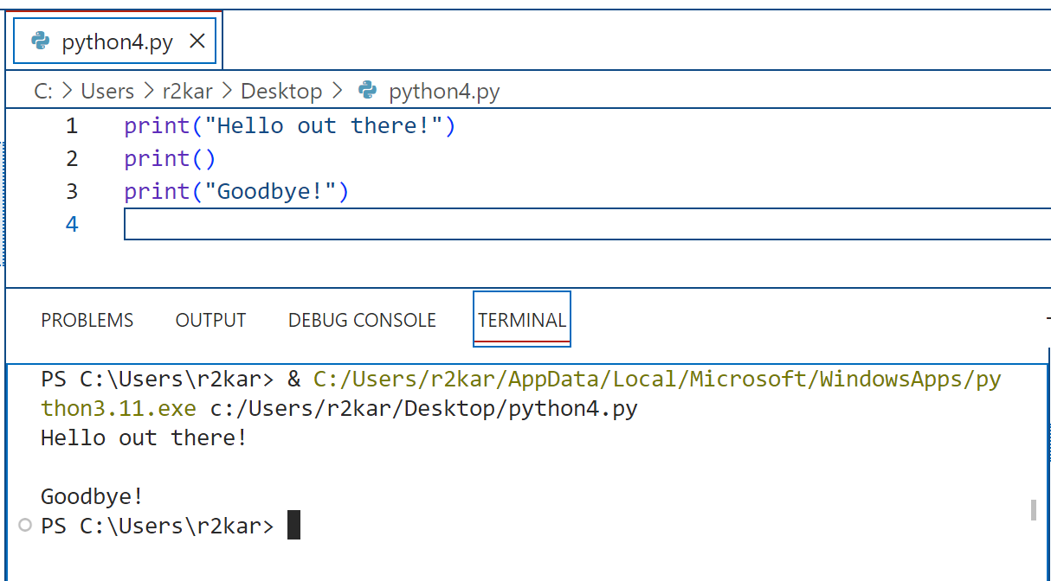
Python Fundamentals
The print() function:

Slide 27
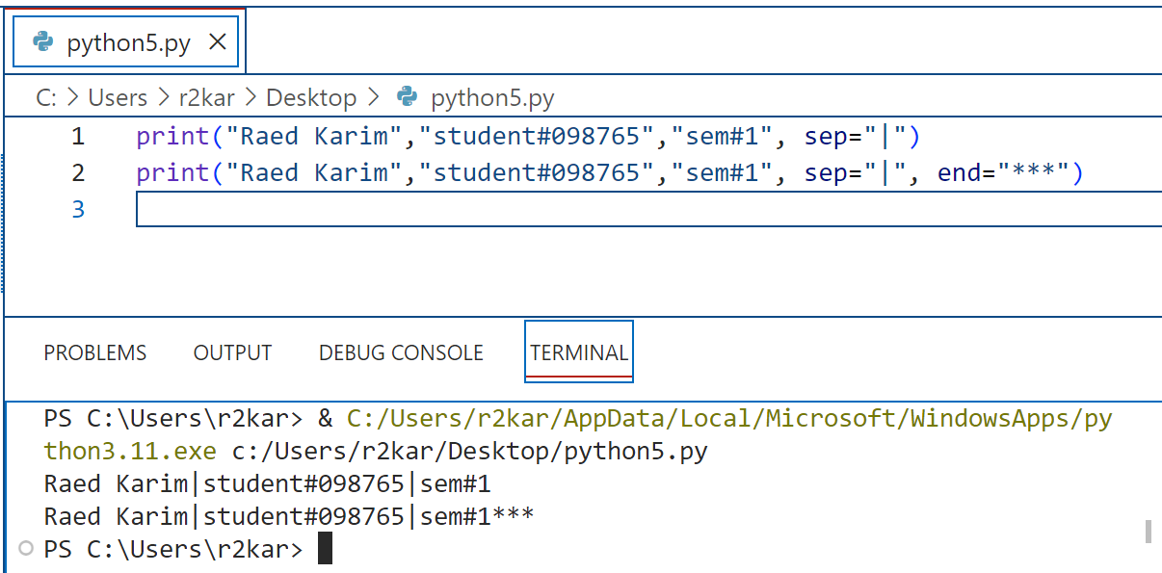
Python Fundamentals
The print() function:
Print can take other arguments like (sep) and (end).
sep: string inserted between values, default a space.
end: string appended after the last value, default a newline.

Slide 28
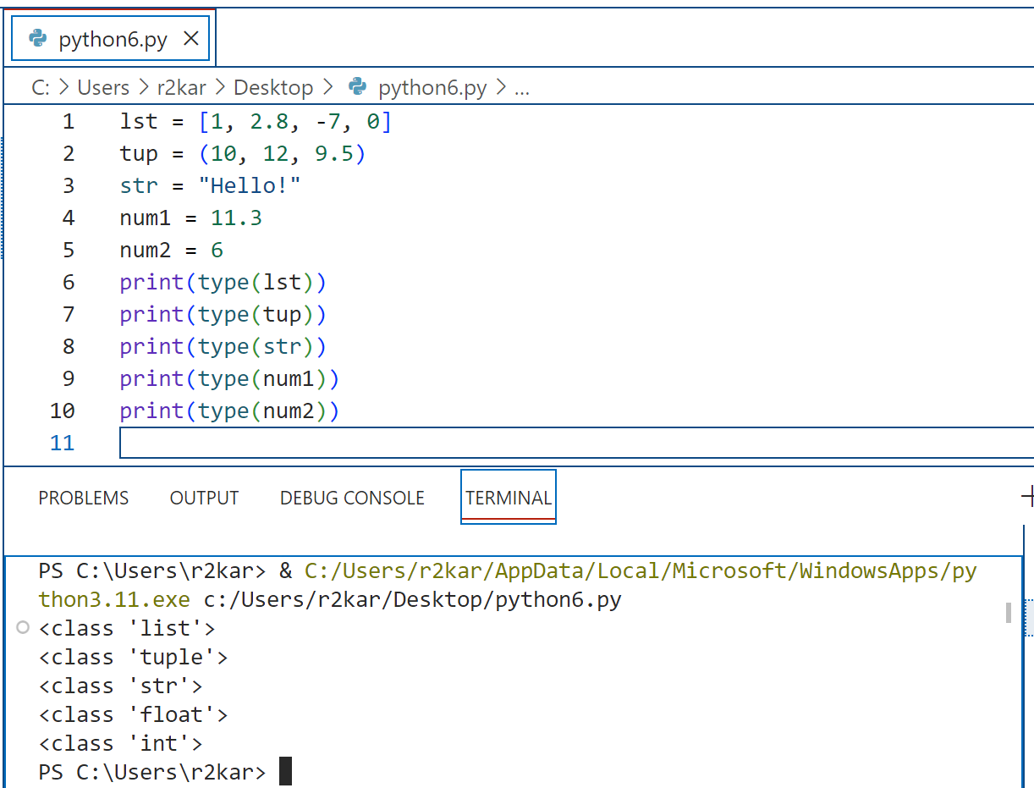
Python Fundamentals
The type() function:
type() is another built-in function that can be used by programmers to debug their code( debugging is the process of identifying and fixing bugs in the software).
It returns the class type of object (data) passed to it, in between the parenthesis.
The example, on the right, shows the data type of list (line 1), tuple (line 2), string (line 3), float (line 4) and integer (line 5).
We will discuss more of the data types later.

Slide 29
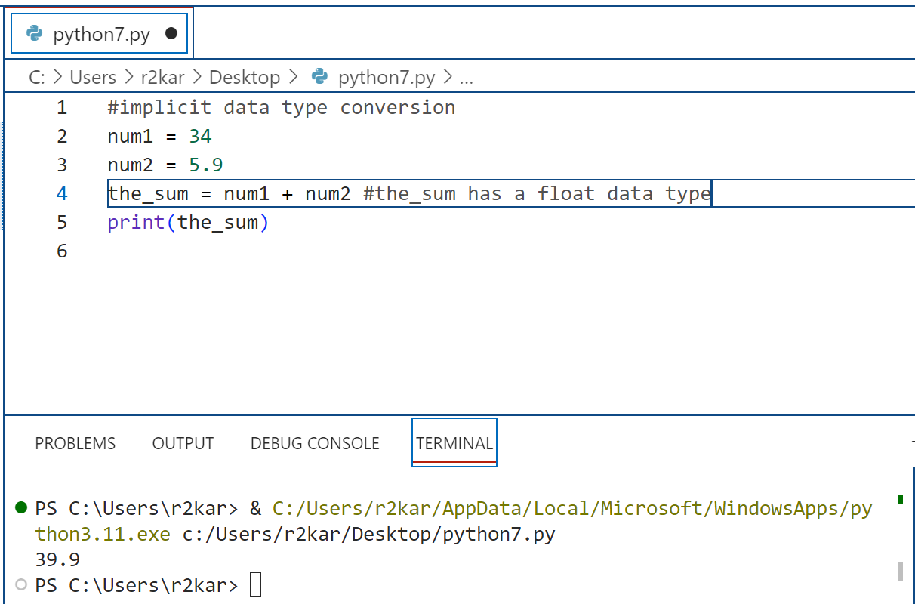
Python Fundamentals
Type casting (conversions):
There are two types of type conversion in python; implicit and explicit type conversions.
In the implicit, python automatically converts one data type to another.
Python can perform the conversion of lower datatypes to the higher without data loss like converting integer to float.

Slide 30
Python Fundamentals
Type casting (conversions):
In the explicit, programmers perform the conversion using some pre-defined functions (e.g., int(), float(), str()).
The int() converts numbers with decimals (e.g., 89.5) or literal values in between quotes ( ‘123’) into integer.
The float() converts integers to float format (adding a zero after the decimal point) or literal values in between quotes into float.
You cannot convert string literal into numbers (e.g., “abc” into a number).
The str() converts values into strings (e.g., 87 into “87”).

Slide 31
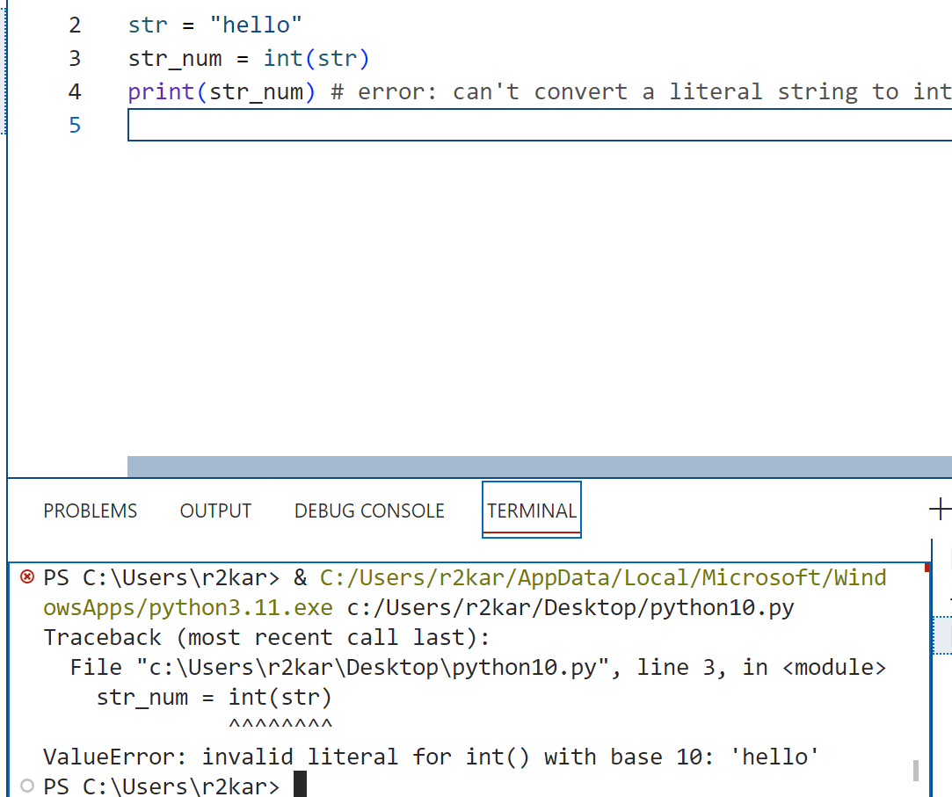
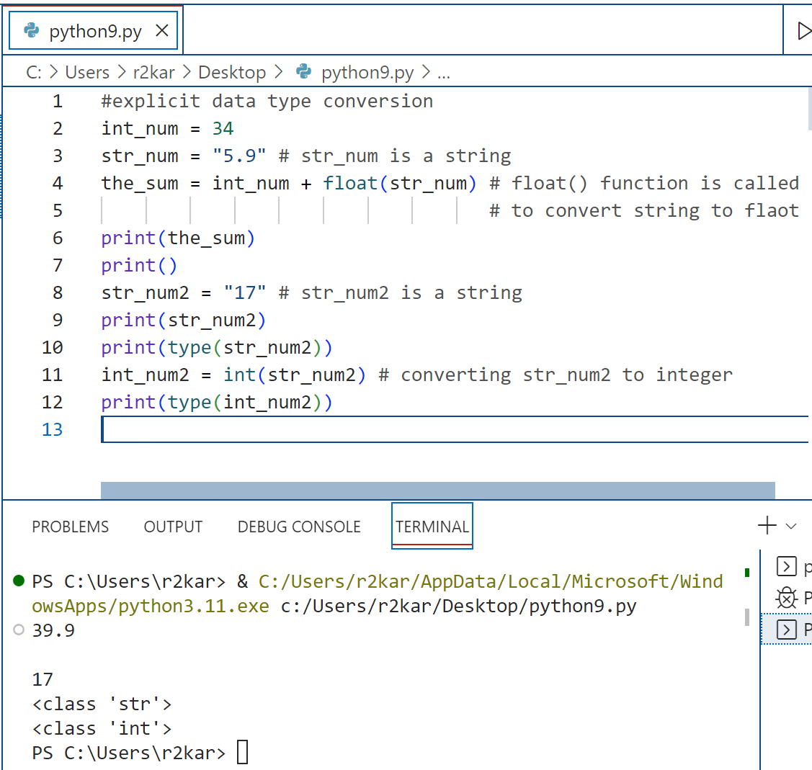
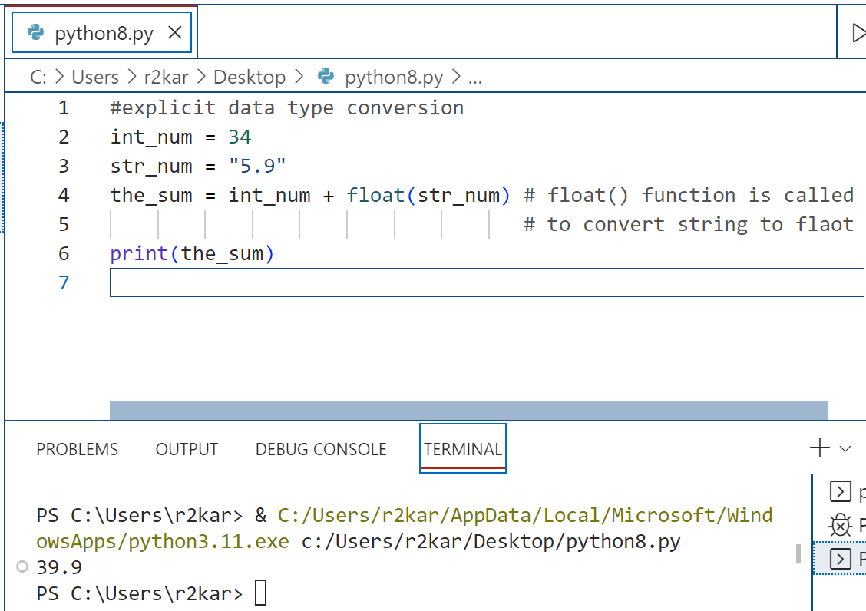
Python Fundamentals
Type casting (conversions):

Slide 32
Python Fundamentals
Types of errors:
As you test your program, three types of errors can occur.
Syntax errors prevent your program from compiling and running. Since syntax errors occur when Python attempts to compile a program, they’re known as compile-time errors. This type of error is the easiest to find and fix.
When you use Visual Studio Code, it highlights the location of the syntax errors that it finds each time you attempt to run the program. Then, you can correct that error and try again.

Slide 33
Python Fundamentals
Types of errors:
Common syntax errors
Misspelling keywords.
Forgetting the colon at the end of the opening line of a function definition, if clause, else clause, while statement, for statement, try clause, or except clause.
Forgetting an opening or closing quotation mark or parenthesis.
Using parentheses when you should be using brackets, or vice versa.
Improper indentation.

Slide 34
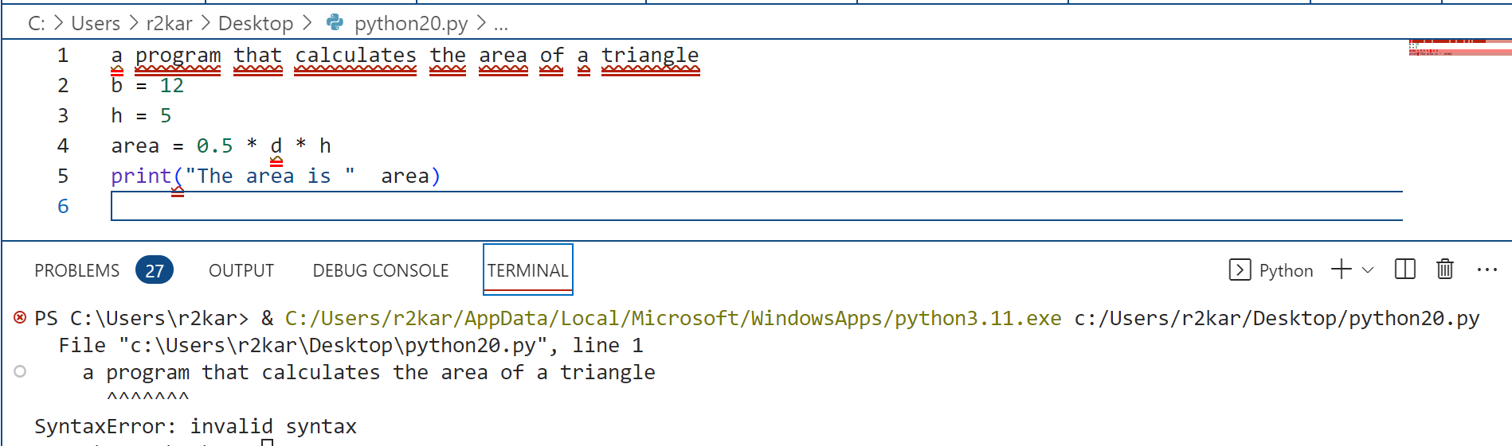
Python Fundamentals
Types of errors:
Syntax error example (can you figure what causes theses errors?!)

Slide 35
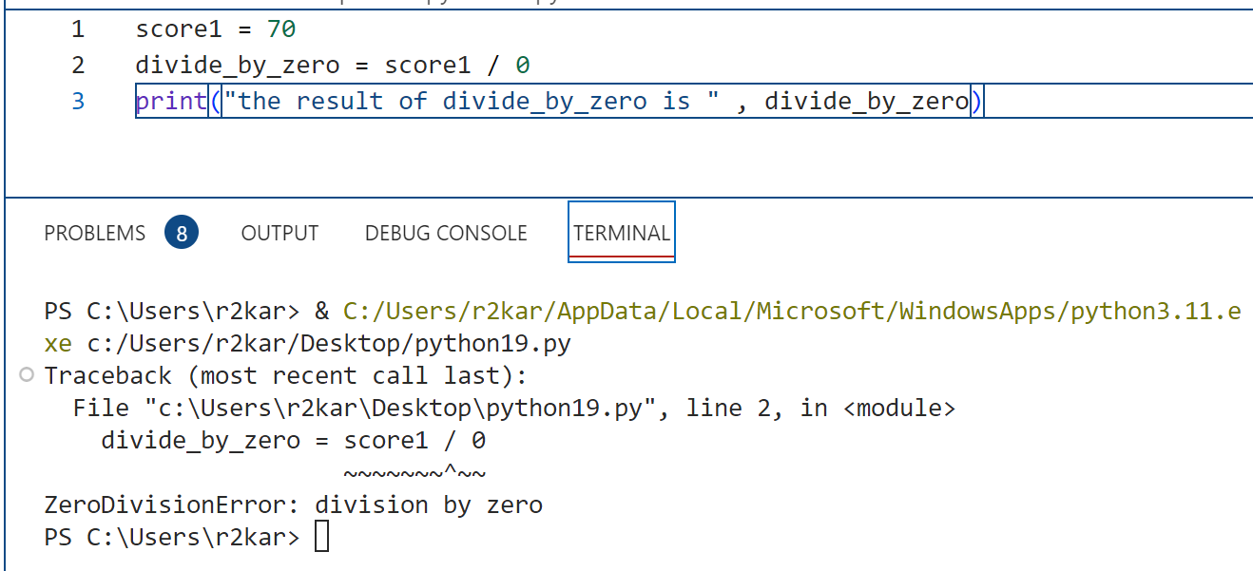
Python Fundamentals
Types of errors:
Runtime errors don’t violate the syntax rules, but they throw exceptions (errors that python interpreter generates and displayed in the console or the terminal) that stop the execution of the program. Many of these exceptions are due to programming errors that need to be fixed.
This example shows the runtime error occurs when trying to divide a value by zero. You notice that there was no syntax error meaning the program was compiled and run and then python threw an exception: ZeroDivisionError: division by zero

Slide 36
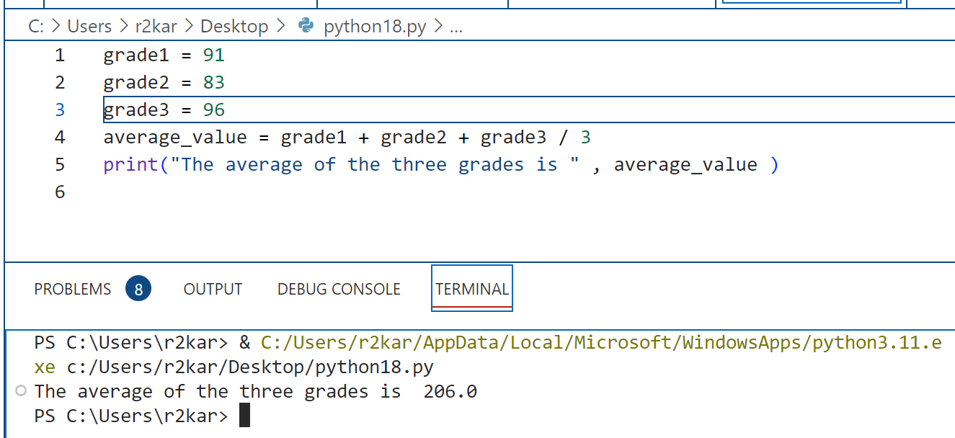
Python Fundamentals
Types of errors:
Logic errors are statements that don’t cause syntax or runtime errors, but produce the wrong results. In the example shown above the program produced a wrong result. The value of average should be 90, not 260.
It is the programmer’s responsibility to ensure that the code is written right so the result is right.
(can you try and fix the error ?!!)

Slide 37
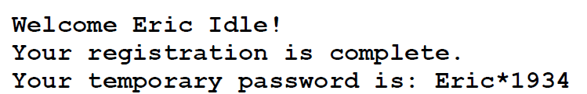
Python Fundamentals
Class exercises: Do it yourself !
Write a python program to produce the following output (define variables and assign values to them, then use print function).

Slide 38
Python Fundamentals
Class exercises: Do it yourself !
Write a python program that contains 4 variables for 4 grades of a student. Assign values to the variables. Find the sum of the 4 grades. Make sure to use explicit continuation for the sum statement. Print the sum and use the end keyword in the print statement. Your program should start with a comment that spans two lines to describe your code.

Slide 39
Python Fundamentals
Class exercises: Do it yourself !
Write a python program that assign 3 tax amounts to 3 variables all in one statement. Then print all the values using one print statement with the sep keyword.

Slide 40
Working with numeric data and arithmetic operations Part - 2

Slide 41
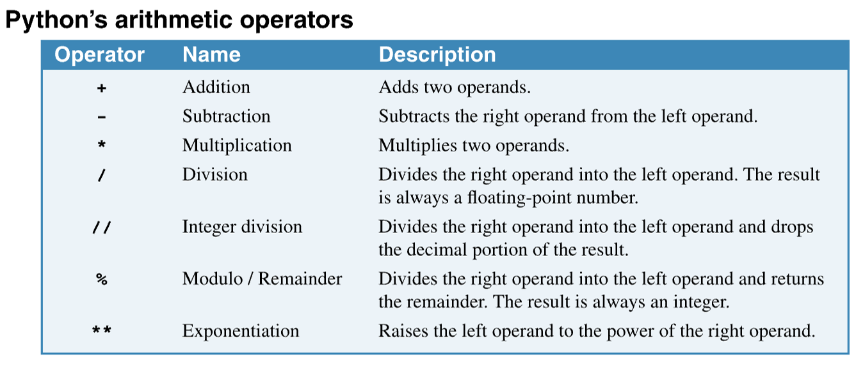
Python Fundamentals
Arithmetic operators consist of two or more operands that are operated upon by arithmetic operators.
The operands in an expression can be either numeric variables or numeric literals.
The +, -, * and / are the same as those used in basic arithmetic.
Python also has an operator for integer division (//) that truncates the decimal portion of the division. It has a modulo operator (%), or remainder operator, that returns the remainder of a division. And it has an exponentiation operator (**) that raises a number to the specified power.

Slide 42
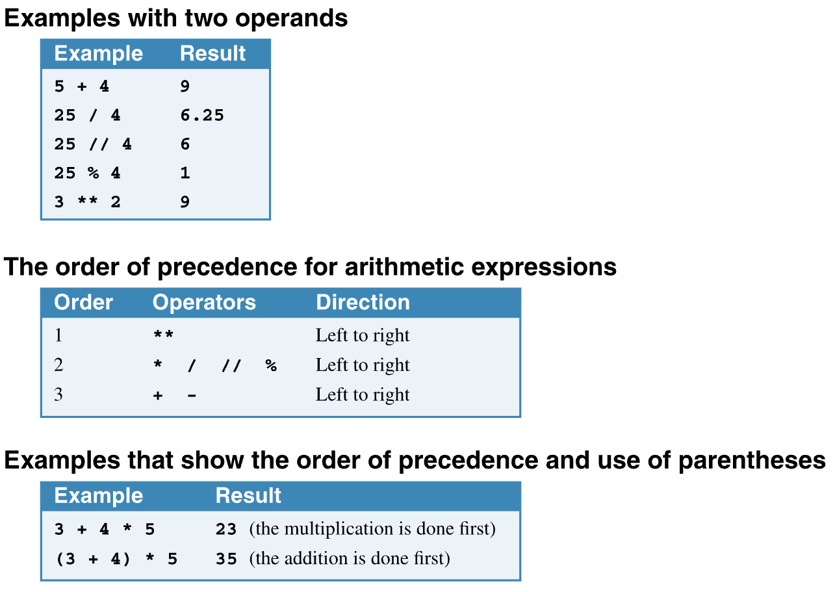
Python Fundamentals

Slide 43
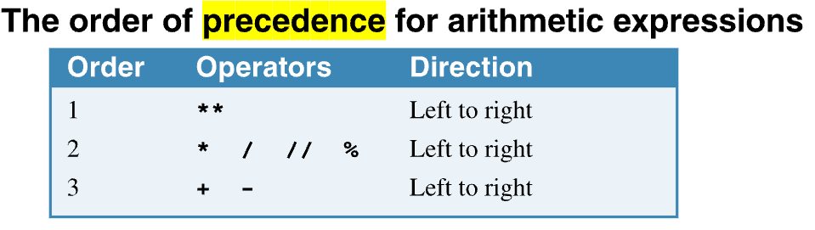
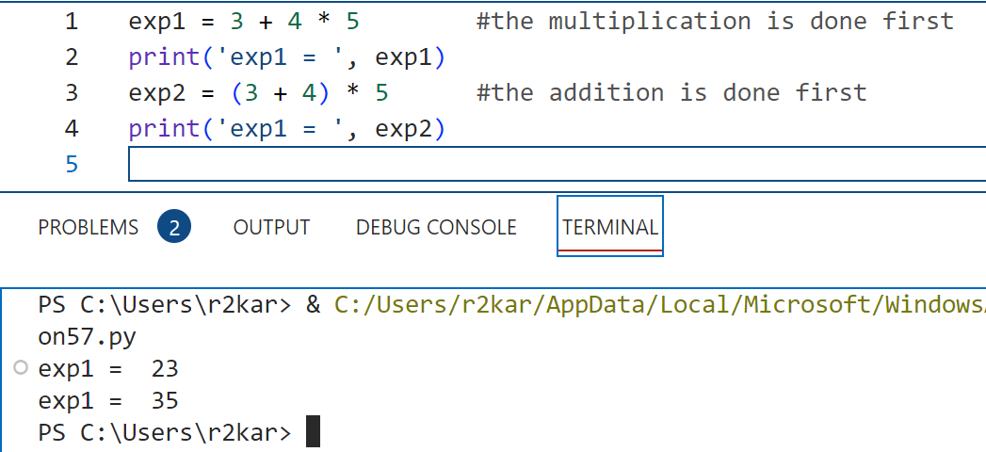
Python Fundamentals
The order of precedence: when an expression includes two or more operators, the order of precedence determines which operators are applied first. This order is summarized in the table in this figure. For instance, Python performs all multiplication and division operations from left to right before it performs any addition and subtraction operations.
If you need to override the default order of precedence, you can use parentheses. Then, Python performs the expressions in the innermost sets of parentheses first, followed by the expressions in the next sets of parentheses, and so on.

Slide 44
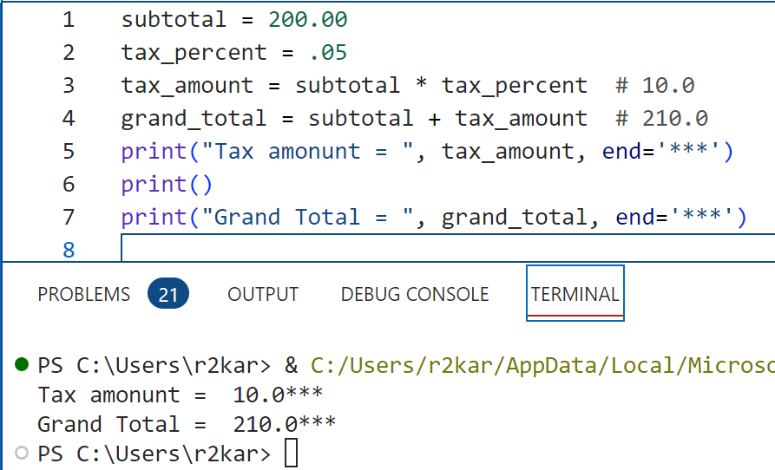
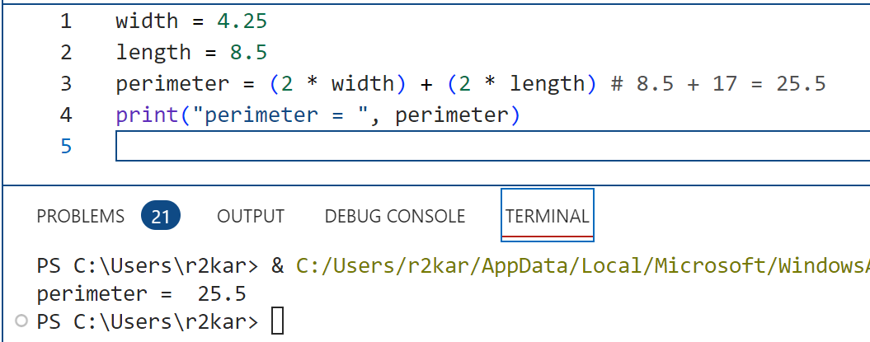
Python Fundamentals
On the right side:
Code that calculates sales tax
Code that calculates the perimeter
of a rectangle

Slide 45
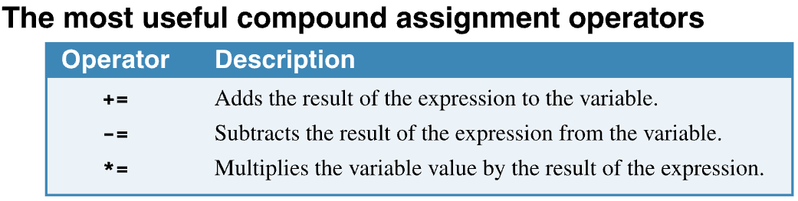
Python Fundamentals
The compound assignment operators provide a shorthand way to code common assignment statements.
For instance, the += operator modifies the value of the variable on the left of the operator by adding the value of the expression on the right to the value of the variable on the left. When you use this operator, the variable on the left must already have been initialized.
The other operators, -= and *= work similarly.

Slide 46
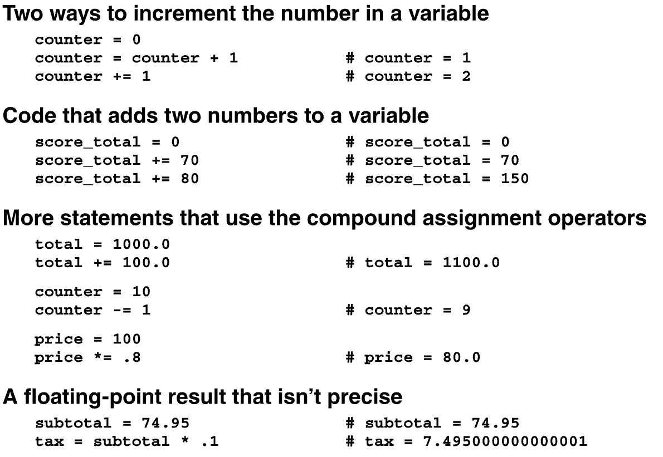
Python Fundamentals

Slide 47
Python Fundamentals
Floating-point numbers:
A floating-point number consists of a positive or negative sign, a decimal value for the significant digits, and an optional exponent.
Floating-point numbers provide for very large and very small numbers, but with a limited number of significant digits. The float type can only use 16 significant digits to store the number.
To express the value of a floating-point number, you can use scientific notation.
This notation consists of an optional plus sign or a required minus sign, a decimal value for the significant digits, the letter e or E, and a positive or negative exponent. For example:
2.302e+5

Slide 48
Python Fundamentals
Floating-point numbers:
In this example, the number contains four significant digits (2.302), and the exponent specifies how many places the decimal point should be moved to the right or to the left. Here, the exponent is positive so the point is moved to the right and the value is: 230,200
But if the exponent was negative (e-5), the point would be moved to the left and the value would be: .00002302
An integer is an exact value that yields expected results.
A floating-point number is an approximate value that can yield unexpected results known as floating-point errors.

Slide 49
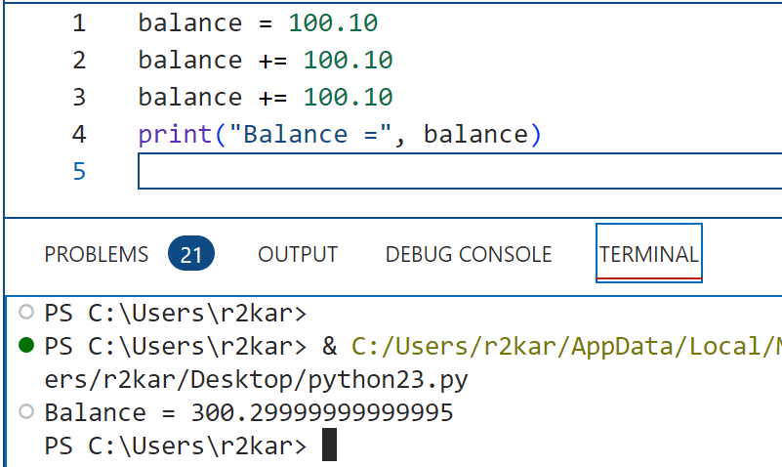
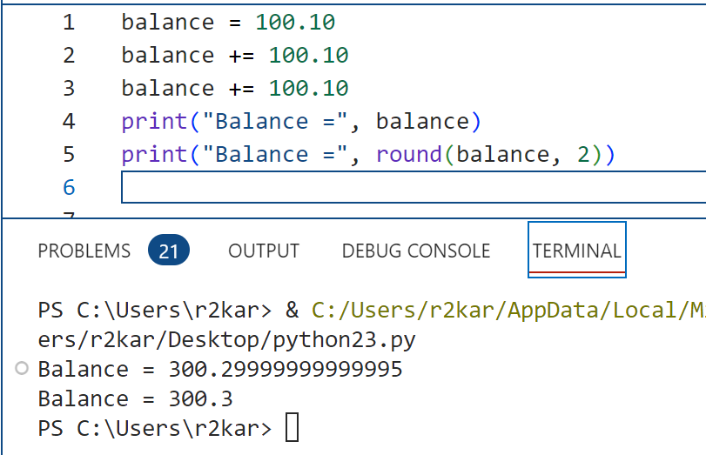
Python Fundamentals
Floating-point numbers:
The floating-point numbers are approximate values, not exact values. Look at this example:
In this example, Balance should be 300.30
As a result, they sometimes cause floating-point errors.
To fix this error, we use round() function. The round()
function can take additional argument which is an integer
that represents the number of digits to display after the
decimal point.

Slide 50
Python Fundamentals
The standard math module:
The math module for Python provides many functions for mathematical, trigonometric, and logarithmic operations.
The floating-point numbers are approximate values, not exact values. Look at this example:
Balance should be 300.30
As a result, they sometimes cause floating-point errors.
To fix this error, we use round() function. The round()
function can take additional argument which is an integer
that represents the number of digits to display after the
decimal point.

Slide 51
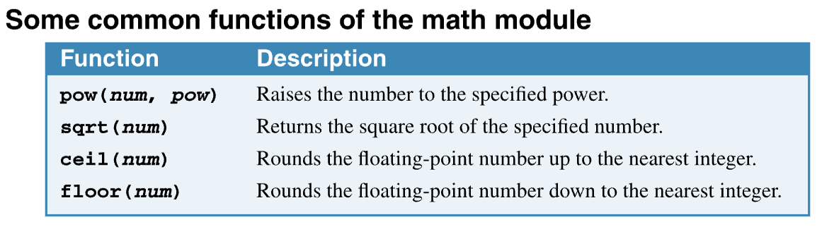
Python Fundamentals
The standard math module:
We list four common functions and the pi constant that required importing the math module.
You can use the ceil() function if you always want to round up (towards the ceiling). And you can use the floor() function if you always want to round down (towards the floor). See examples in next slide
* you can also use the exponential operator (**) to raise a number to the power.

Slide 52
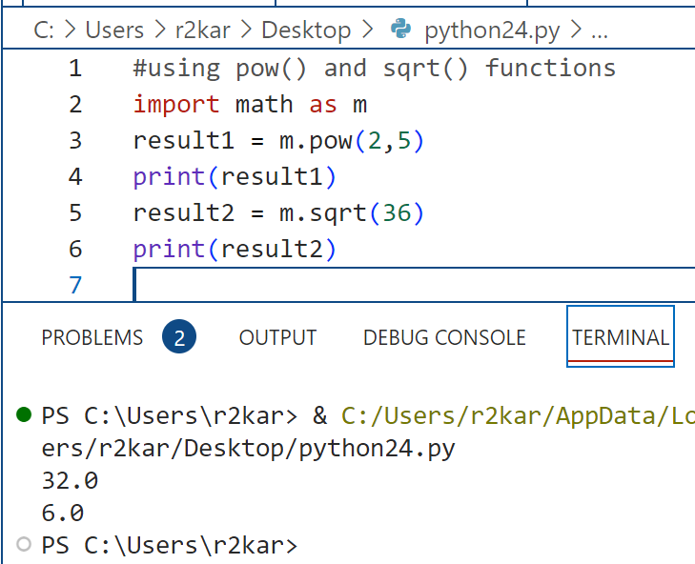
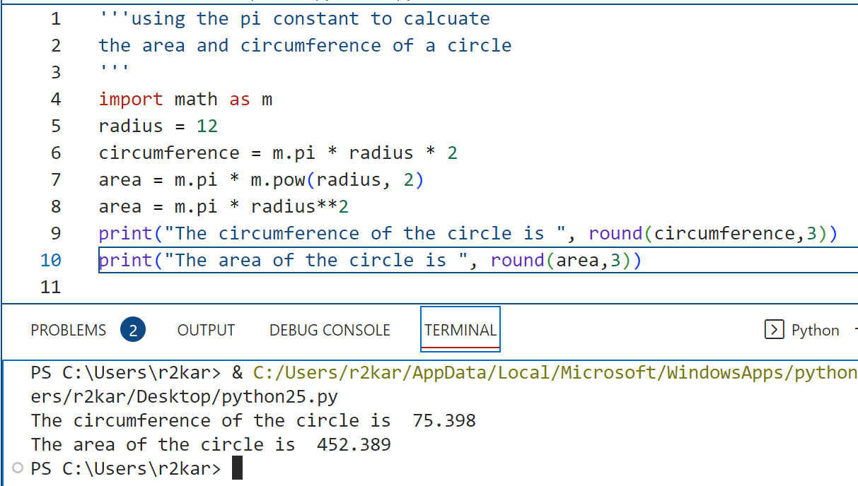
Python Fundamentals
The standard math module:
The m in the import statement is called alias that is defined so we use through the program instead of using the module name – math.

Slide 53
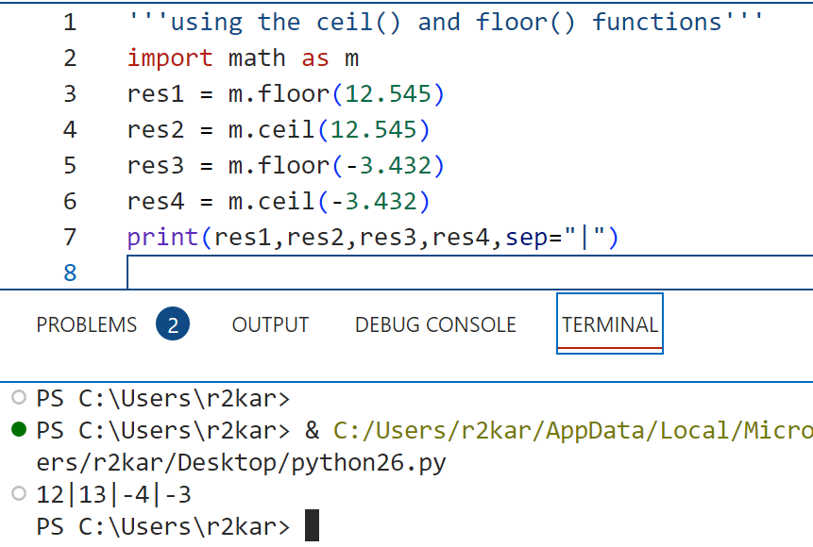
Python Fundamentals
The standard math module:
The m in the import statement is called alias that is defined so we use through the program instead of using the module name – math.

Slide 54
Python Fundamentals
Class exercises: Do it yourself !
Create a program that calculates a user’s weekly gross and take-home pay.
Follow the Console (on the right) and assign values to the hours Worked and hourly pay rate.
Specifications
The formula for calculating gross pay is:
gross pay = hours worked * hourly rate
The formula for calculating tax amount is:
tax amount = gross pay * (tax rate / 100)
The formula for calculating take home pay is:
take home pay = gross pay – tax amount
The tax rate should be 18%, but the program should store the tax rate in a variable so
you can easily change the tax rate later just by changing the value that’s stored in the variable.
Console
Pay Check Calculator
Hours Worked: 35
Hourly Pay Rate: 14.50
Gross Pay: 507.5
Tax Rate: 18%
Tax Amount: 91.35
Take Home Pay: 416.15

Slide 55
Python Fundamentals
Class exercises: Do it yourself !
Create a program that calculates total sales and dsplays the following information to the console.
Follow the Console (on the right) and assign values to the cost of the meal and the tip percent.
Specifications
The formula for calculating the tip amount is:
tip = cost of meal * (tip percent / 100)
Console
Tip Calculator
Cost of meal: 52.31
Tip percent: 20
Tip amount: 10.46
Total amount: 62.77

Slide 56
Python Fundamentals
Class exercises: Do it yourself !
Create a program that converts the temperature in Celsius into Fahrenheit and vice versa.
Follow the Console (on the right) and assign values to the cost of the meal and the tip percent.
Specifications
The formula for calculating the tip amount is:
Fahrenheit = (Celsius * 9/5) + 32
Celsius = (Fahrenheit – 32) * 5/9
Console
Temperature conversion Calculator
In Celsius: 20.0
In Fahrenheit: 68.0
In Fahrenheit: 68.0
In Celsius: 20.0

Slide 57
References
Material has been taken from (can be accessed through Sheridan's Library Services) :
Starting Out with Python (ISBN-13: 9780136912330 ):
https://www.pearson.com/en-ca/subject-catalog/p/starting-out-with-python/P200000003356/9780136912330
Murach’s Python 2nd Edition programming, 2nd Edition :
https://bookshelf.vitalsource.com/reader/books/9781943872756/pages/recent
Introducing Python, Lubanovic, B., O'Reily Media, 2nd Edition, 2019
https://www.oreilly.com/library/view/introducing-python-2nd/9781492051374/

